Slide 1
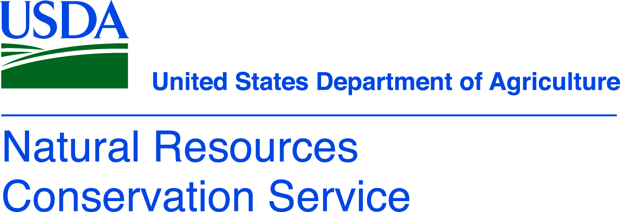
Bacteria in Soil

Slide 2
Bacteria
Widely variable to air, moisture, temperature, and acidity tolerance in habitat
Consume chitin and cellulose
Autotrophs - organism that is able to form nutritional organic substances from simple inorganic substances such as carbon dioxide.
Nitrogen fixation and release
Some bacteria will release nutrients to the plant
Some bacteria will protect the plant from diseases
Some are parasites and/or cause plant disease

Slide 3
Bacteria
Microorganisms (specifically bacteria) need right condition – water, pH, oxygen, temperature, food (carbon organic matter).
Up to 90% of microorganisms can be in soil in a ‘resting’ state until conditions become just right.

Slide 4
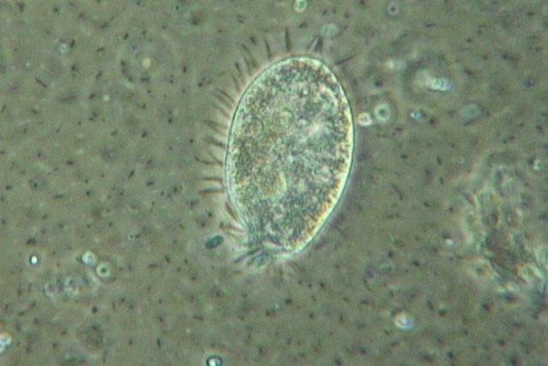
Bacteria in Soil
Much of soil organic matter is the remains of microbial cells rather than plant cells
Tilling provides oxygen to the bacteria speeding up their metabolism and respiration.
They eat more of the available organic matter and release the carbon dioxide into the atmosphere.
No-till slows down respiration.

Slide 5
Symbiosis
Some bacteria will protect the plant from drought by covering the root in a sticky biofilm that minimizes water loss.
Plant produces root exudates (sugars) that feed the microbiome.
The plant is incentivizing different organisms to a symbiotic relationship.
Plant sends hormones into the soil attracting soil bacteria live on the root or enter and live in the plant root.
Example 1: When a plant needs for example zinc the plant sends sugars to feed a specific bacterium that can release zinc from the mineral reserves of the soil.
Example 2: A different bacterium is capable of releasing copper.

Slide 6
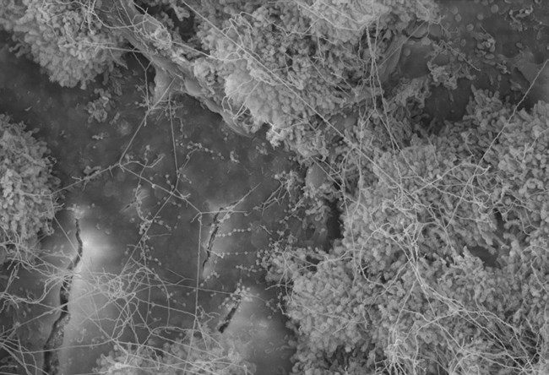
Bacteria – Building Soil Structure
Bacteria produce a sticky polysaccharide (carbohydrate like starch) that helps holds soil particles together to form aggregates.
Actinobacteria have filaments that bridge two minerals together that help build soil aggregates.

Slide 7
Cellular Respiration The data below shows measured microbial activity from four soil samples from different habitats – a cultivated corn field, overgrown farmland, a lawn, and a undisturbed forest.
Can you predict which bar on the graph represents which sample site?
Overgrown farmland
Lawn
Cultivated corn field
Undisturbed forest

Slide 8
Cellular Respiration Explain the data
The forest microbial activity was likely low because woody vegetation is rich in lignin and more difficult to break down compared to cellulose found in grasses at the other sites.
An overgrown field would have a rich supply of organic matter compared to the cornfield or lawn.
An overgrown field would have less disturbed soil microbe community

